Slide 1
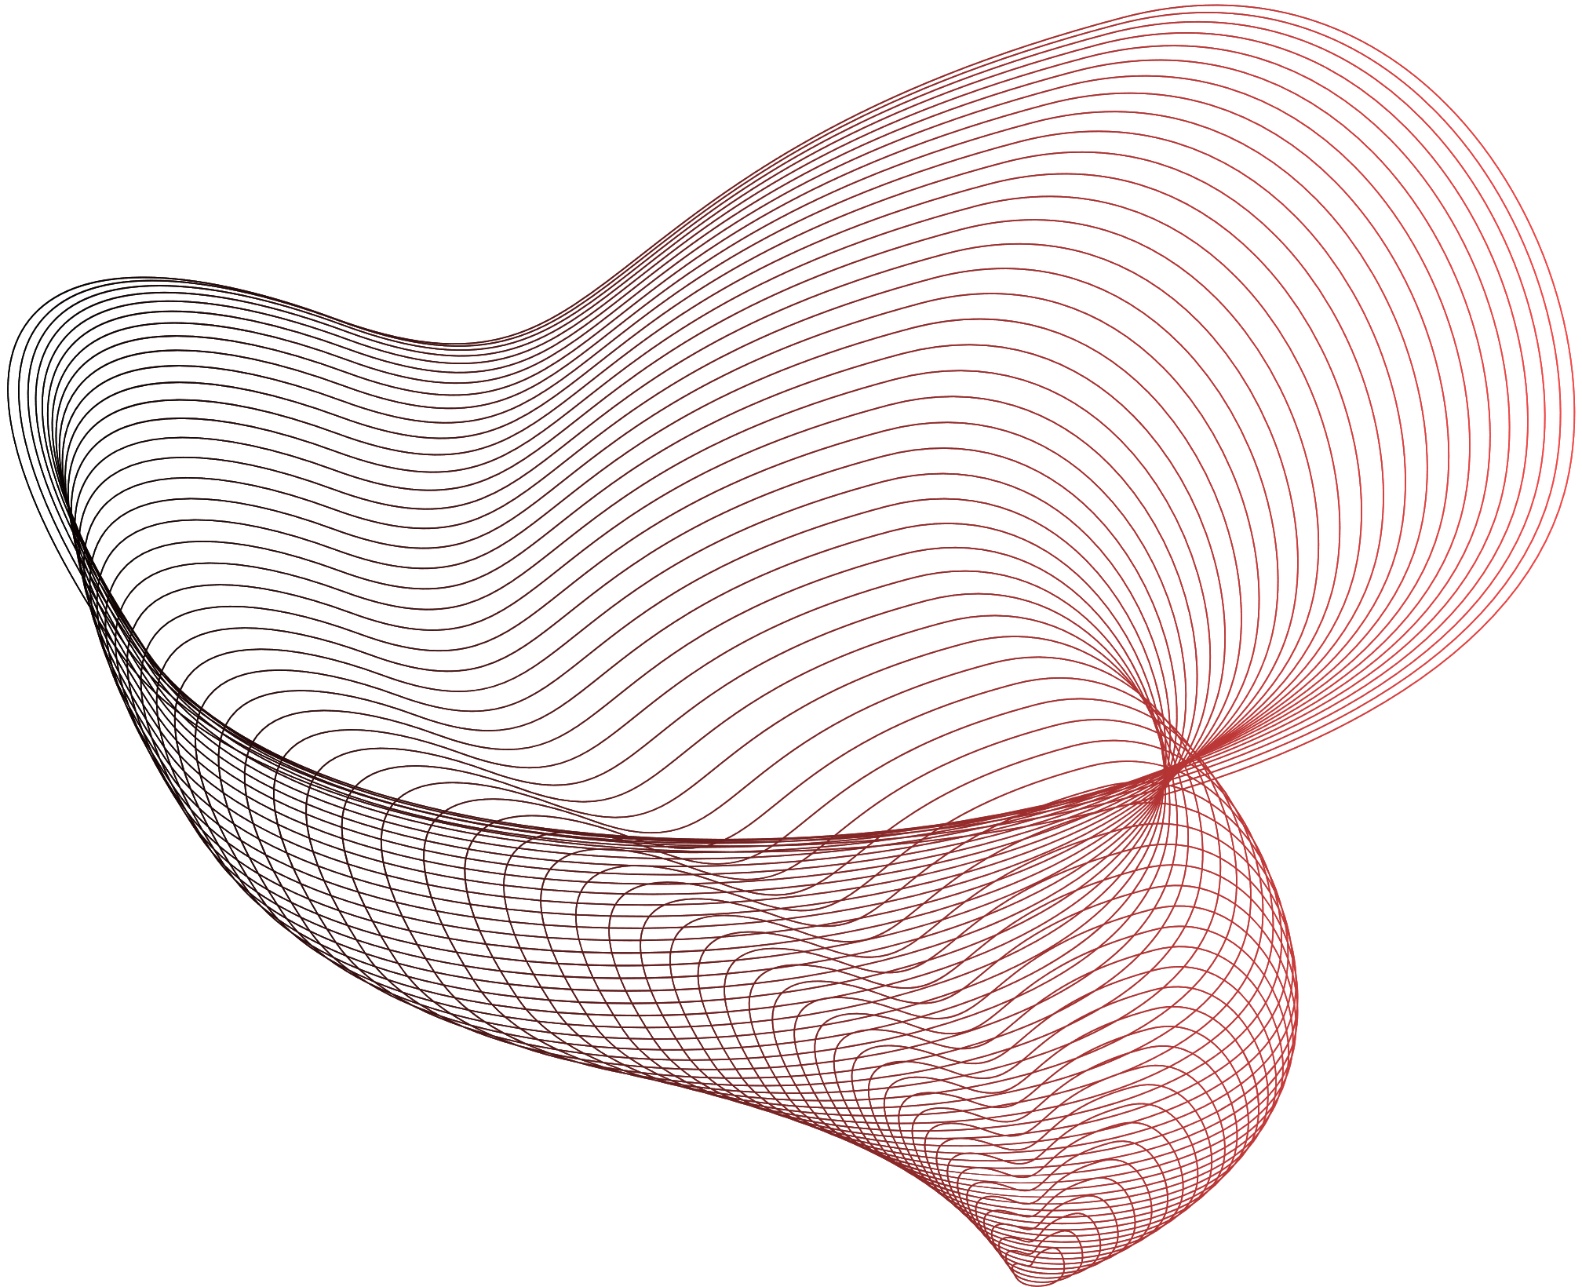

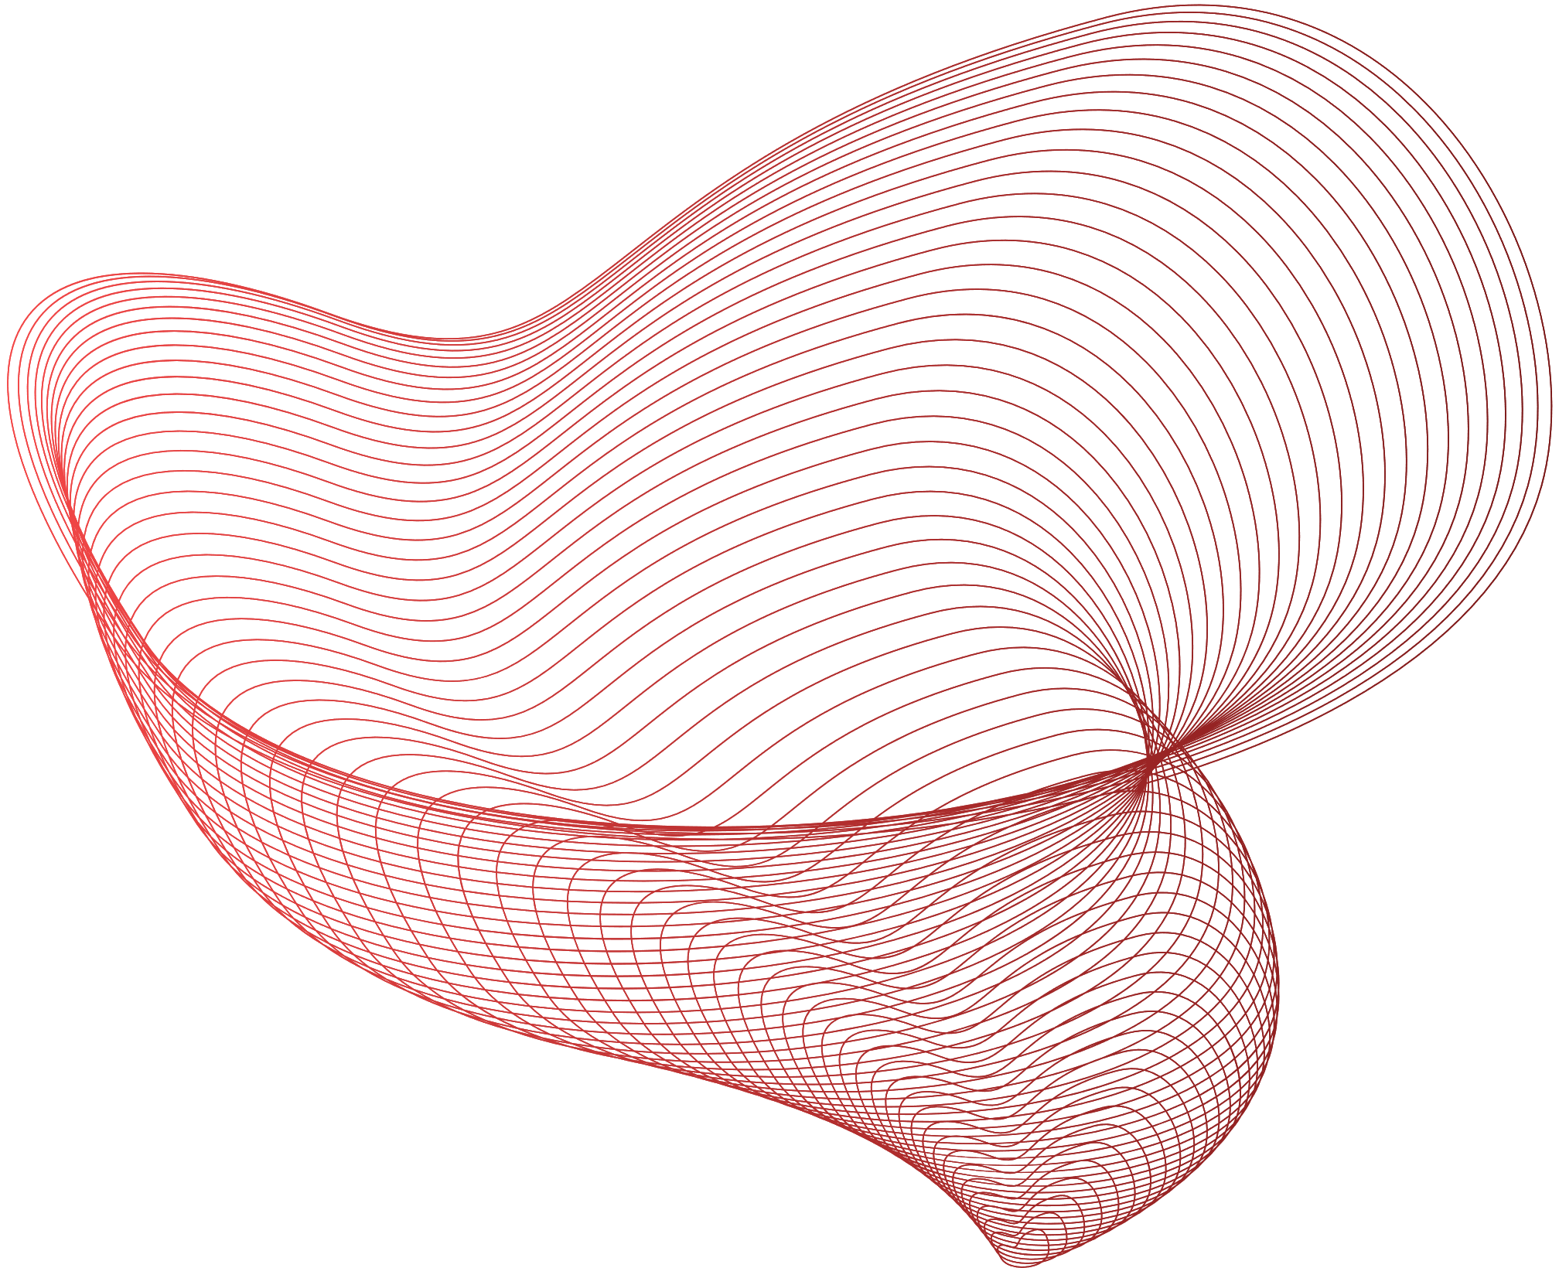
DATA SCIENCE PROJECT
CS21B1069
Rahul k

Slide 2
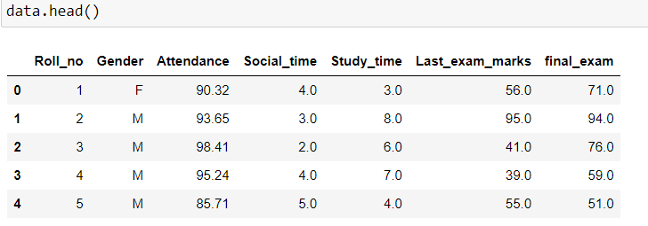
Problem statement or topic of project:
Predicting students final exam marks based on his mid exam marks attendance and time he spends on social media like Instagram etc and time he spends on studies.
Source of dataset:
Oops course attendance and marks sheet
Features in our data set : ROLL_NO,GENDER,SOCIALMEDIA SPENT TIME,STUDY TIME,MARKS IN PREVIOUS EXAM and Dependent Feature FINAL EXAM MARKS.

Slide 3
DATA PREPARATION
We have to process our data so that it would be easy for analysis and prediction and will also increase accuracy of our model.
So we have to clean our data by removing null values and outliers in our data, drop irrelevant columns and can add extra columns to make data more precise.
We have to remove duplicates in our data, at last if we have derived columns like if Attribute A can be derived from attribute B, then we can drop Attribute B

Slide 4
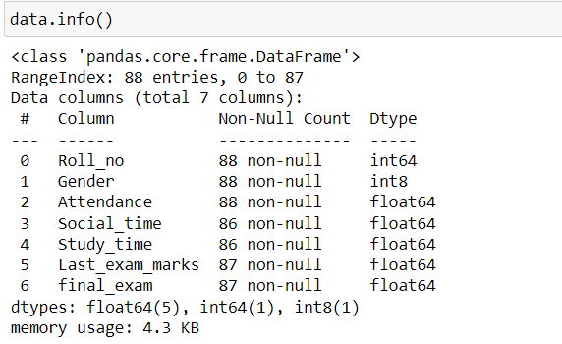
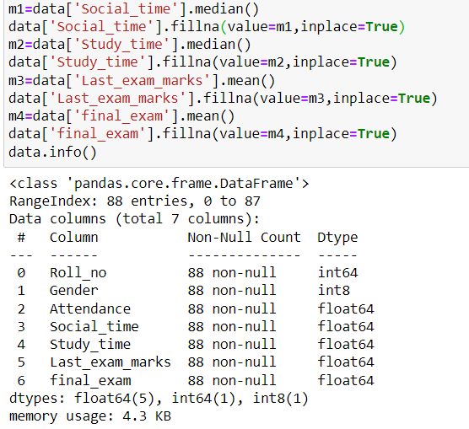
Identifying nan values and replacing them using imputation methods else we can drop that data point but as our data is less than 100 rows dropping data might cause loss of essential data
After removing Null values

Slide 5
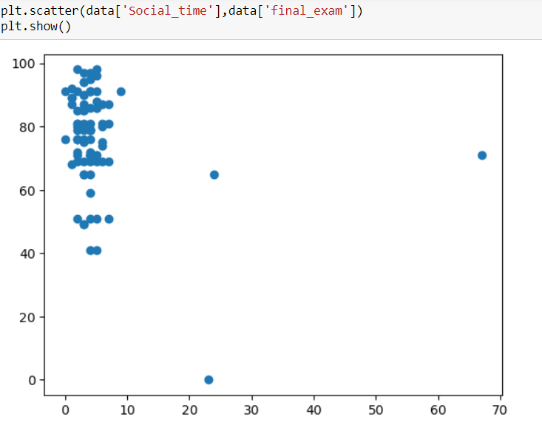
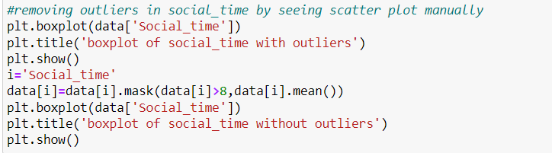
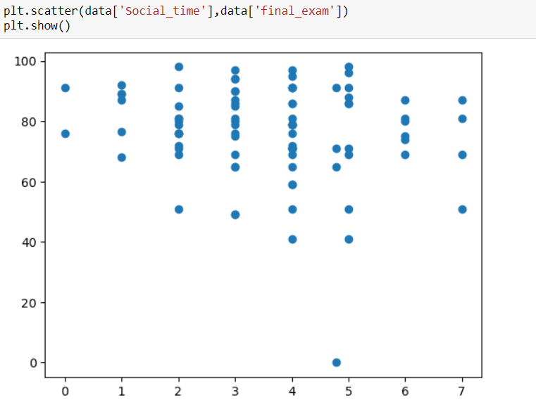
We have to remove outliers in our data which affect our data analysis we can do it using scatter plot and boxplot.
After removing outliers

Slide 6
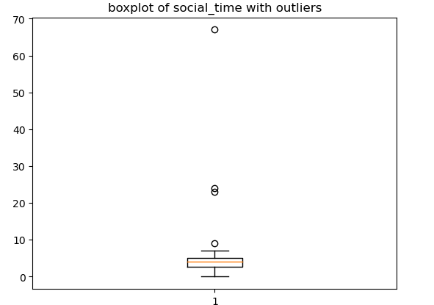
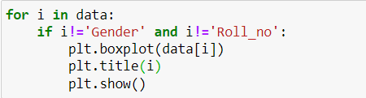
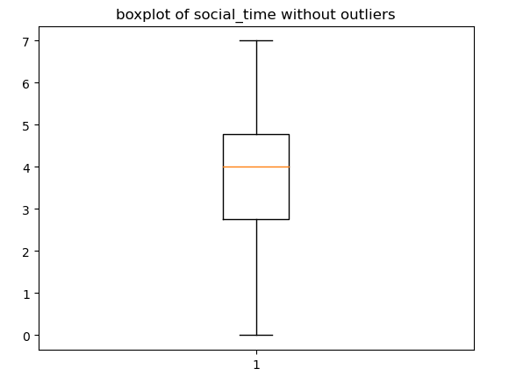
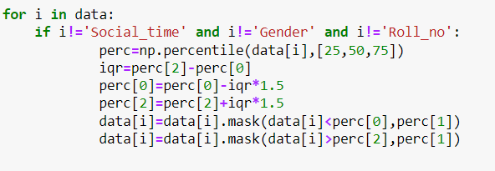
We can also use boxplot to remove outliers.
To check for outliers in each column
OUTLIER
To replace outliers with median of attribute by calculating 25 percentile,75 percentile and iqr and then setting the Min and Max and assuming data points outside these are outliers
IQR*1.5
75 per
median
IQR
25 per
IQR*1.5

Slide 7
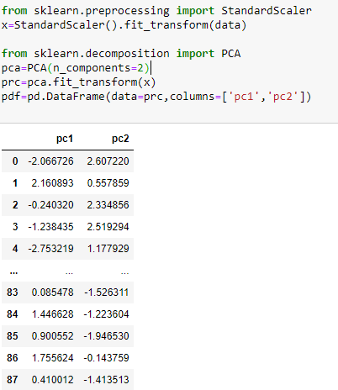
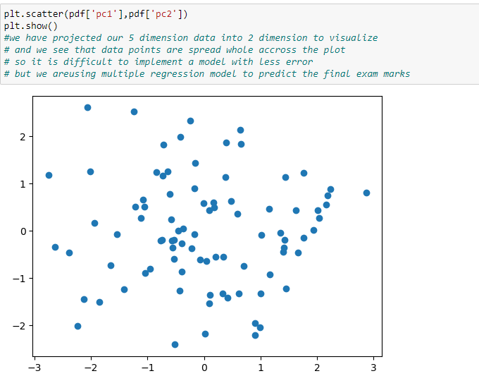
Visualizing data by reducing dimension using PCA and plotting the projection of data points of 6 dimension on 2d plane

Slide 8
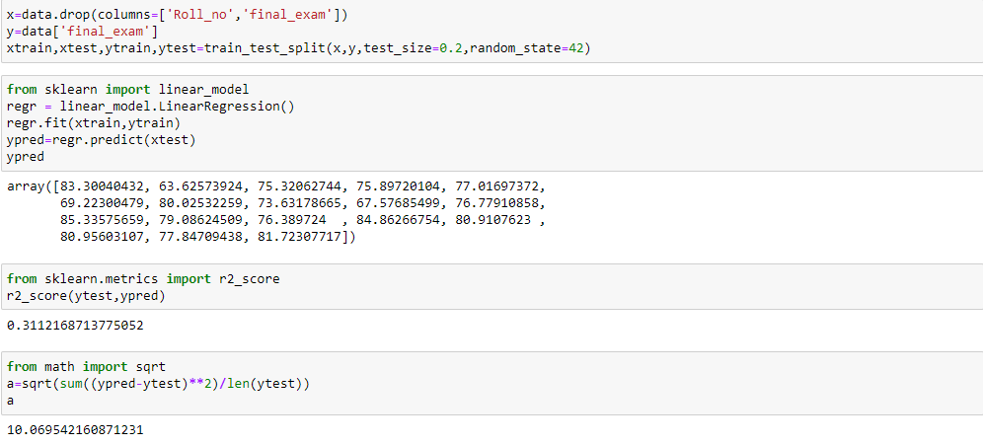
FINAL STEP : IMPLEMENTING ML MODEL FOR PREDICTION AND ANALYSING THE PERFORMANCE OF OUR DATASET
WE ARE USING MULTIPLE REGRESSION TO PREDICT THE FINAL MARKS AS IT IS A REGRESSION TASK.
MODEL EVALUATION CAN BE DONE USING R2_SCORE OR RMSE WHICH ARE FAMOUSLY USED METHODS TO KNOW ACCURACY OF MODEL
AND WE CAN SEE RMSE OF 10 IS NOT A GOOD SIGN INDICATING OUT MODEL IS NOT THAT ACCURATE OR HAS HIGH RATE OR ERROR SO THIS DATA DOESN’T FIT ACCURATELY FOR MULTIPLE REGRESSION ALGORITHM.

